Slide 1
Student Performance Monitor
Submitted by group 2

Slide 2
Prepared by
Muhammad fahimul huq 1610044
Shoban Bhowmik 1930533
Airin Sikder Onamika 1822098
Kazi Tokir Ahmed Shawon 1821890

Slide 3
INTRODUCTION
Student progress monitoring is a practice that helps teachers continually evaluate the effectiveness of their learning and use student performance data to make more significant instructional decisions. If the rate at which a particular student is learning seems inadequate, the teacher can adjust the instruction. Our project seeks to create user-friendly software that will serve as a platform for many to improve the quality of education of students, faculty, and other members of the university and in advanced technology in the field of education. We believe that the information we have collected, evaluated, and equipped will lead to opportunities for greater advances in our education and will also make a significant contribution to computer science.

Slide 4
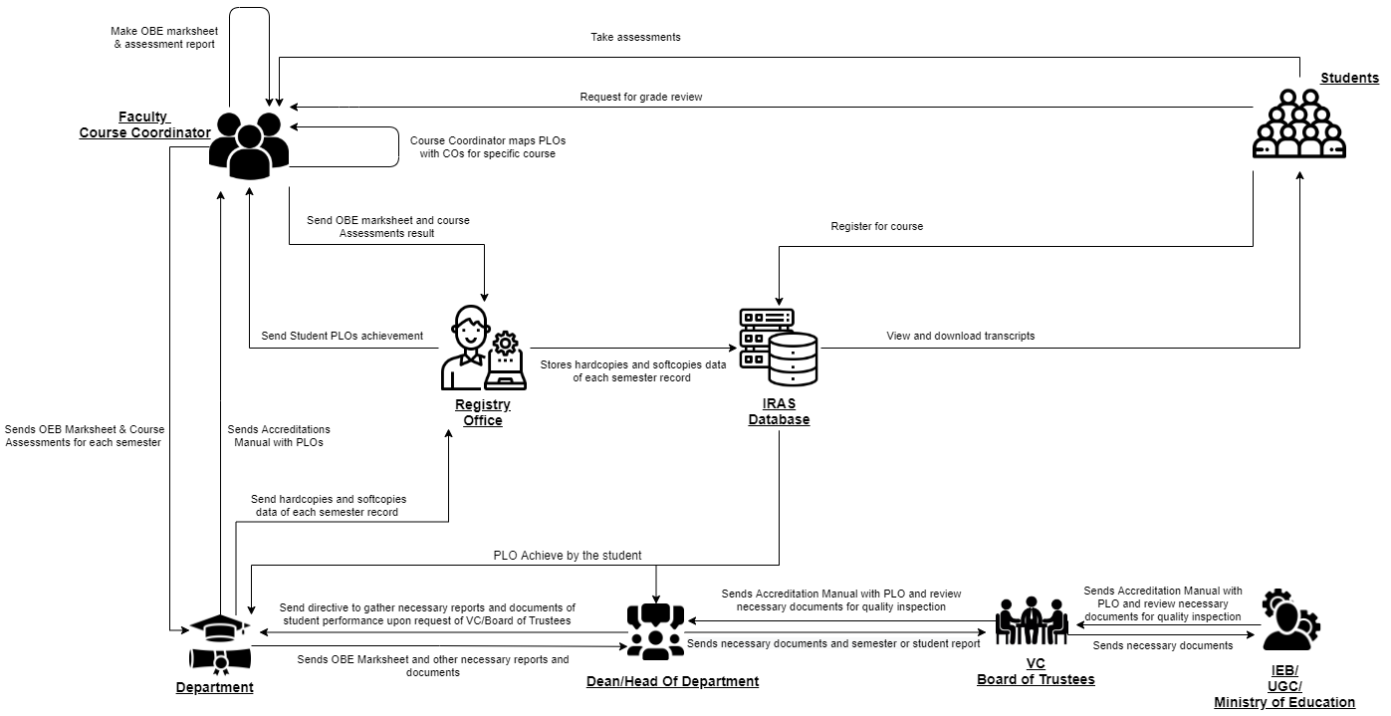
Rich Picture (AS-IS)

Slide 5
SIX ELEMENTS (AS-IS)
Process | System Roles
 | Human | Non-Comp Hardware | Computing Hardware | Software | Database | Network & Communication
Map Course Outcomes (COs) to Program Learning Outcomes(PLOs) | IEB/UGC/ Ministry of Education: 1. Send Accreditation Manual with PLOs defined to VC/ Board Of trustees. VC/ Board Of trustees 1. Receive Accreditation Manual from IEB. 2. Send the Accreditation manual to Department Staff. Head of Department / Dean of School: 1. Send the Accreditation manual to Department Staff. 2. Direct Department Staff to tell Course Instructors and Coordinators to design Course Outline and Course Assessment Reports. Department: 1. Send Course Instructors the Accreditation Manual with defined PLOs. Course Instructor: 1.Check if previous course content is present from the register office, otherwise make new course content. 2. List COs. 3. Map Course Content to Course Outcomes (COs). 4. Map COs to PLOs. 5. Map COs to specific questions of Mid-term, Final Exams questions, and Project Work. 6. Starting to design course assessment reports using course outline, Course Content, and COs. Register Office: 1.Send course content to course instructor if available otherwise send a negative message. | Pen and paper: 1. Is used for noting down intermediate brainstorming ideas. Board and marker: 1. Is used for noting down intermediate brainstorming ideas. | Computer: 1. Course Coordinators use computers to make soft copies of Course Outcomes (COs) of the specific courses they are experts in. Printer: 1. To print out hard copies of Course Outcomes (COs). | MS Word: 1. Course Coordinators use MS Word to make a detailed course outline and Course Assessment Reports with Course Outcomes (COs) mapping to Program Learning Outcomes (PLOs). Excel Sheet: 1. Excel Sheet is used by Course Coordinators to map specific questions in the Midterm, Final exams and Project work to specific Course Outcomes (COs). | IRAS Database server: 1. IRAS uses a database server to store and maintain student grades’ information. | 1. Use the internet and emails to communicate with UGC/IEB or other stakeholders to discuss important topics related to mapping Course Outcomes to Program Learning Outcomes. Others: 1. Use phones or physical means with stakeholders to discuss important topics related to mapping Course Outcomes to Program Learning Outcomes.

Slide 6
Process | System Roles
 | Human | Non-Comp Hardware | Computing Hardware | Software | Database | Network & Communication
Check Number of student enrollment in a department | Student: 1. Students enroll in a specific Degree program. 2. Student information is sent to the register’s office. Register Office: 1.Gather all the new student’s information. 2. Assign the data in a sheet of student information of designated departments. 3.Send the new update data to each department. Department: 1.Receive the data of the new student. 2.Update it in the existing database 3. Send the data to department heads or deans for further inspection Department Head/Dean: 1.Receive the data from the department. 2.Make a calculation of the number of new student enrollment comparing to previous cases. 3. Make calculation number of categorizing students, such as merit based, physical aid, and others | Pen and Paper 1. Sheet of a number of students in a department is made along with student’s information. | Computer/ Phone: 1. Uses computers to make softcopies of reports or sheets of student information in departments. Printer: 1. Print hardcopies of report and sheet | Coded Excel sheet: 1.Department head or dean uses automated excel sheets to calculate the number of students in the department. MS Word: 1. Used to make report softcopies. | Department Storage: 1. Records of students’ enrollment in the department. Registrar’s Office Storage: 1. Records of students’ enrollment for all the departments. | Internet/Mail: 1. An Online platform (such as Google Sheets) may be used for processing the student information data spreadsheet.

Slide 7
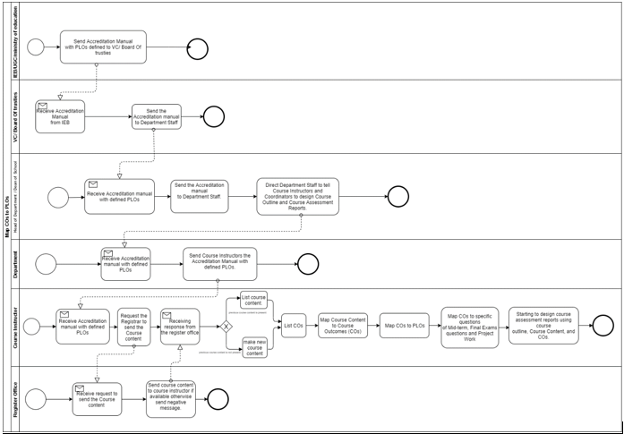
PROCESS DIAGRAM (AS-IS)
Figure 2.3: Process Diagram for Map COs to PLOs

Slide 8
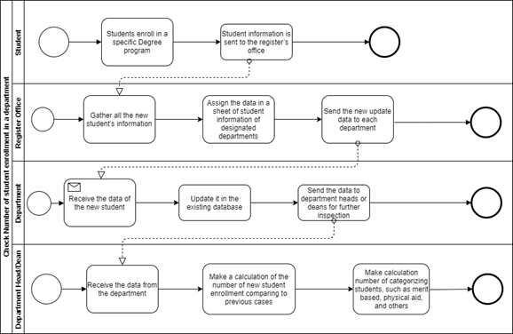
Figure 2.4: Process Diagram for Check Number of student enrollment in a department

Slide 9
Problem Analysis
Process Name | Stakeholders | Concerns (Problems) | Analysis (reason of the problem) | Proposed solution
Map course outcomes (COs) to program Learning Outcomes (PLOs) | 1.Faculties | 1.VC has to collect and send CO and PLO data to the Dean. 2.Dean sends data to department head and then it is passed to department. 3.Course instructor implements CO and PLO in their course. | The process is very complicated and time consuming as faculties must wait for other non-essential stakeholders to implement PLO and CO in their courses. | We can eliminate the involvement of department by giving faculties direct access to update PLOs and COs in our software and department head to update the PLO after further inspection

Slide 10
Process Name | Stakeholders | Concerns (Problems) | Analysis (reason of the problem) | Proposed solution
Check number of student enrollment in a department | 1.Department 2.Dean | 1.Register office collects all the new student’s information. 2.Register office sends updated data to each department. 3.Department updates data to database. Then sends new data to Dean. 4. Dean makes calculation to see student enrollment comparison. | Same information is being send to different stakeholders individually. Which creates unnecessary repetition. Which makes the overall process time consuming. | We can make this information centralized, so that all the stakeholders can see latest information any time. We can also generate custom comparison Graphs/charts for any individual stakeholder.

Slide 11
Process Name | Stakeholders | Concerns (Problems) | Analysis (reason of the problem) | Proposed solution
View records, OBE marksheets and Course assessment report | 1.IEB/UGC 2.Dean 3.VC 4.Faculty | 1. Faculty can’t access the OEB marksheet directly 2. Calculations have to done manually and charts have to make manually to make comparison | Too many manual processes which takes time and resource. Therefore, lowers overall efficiency | We will generate automated charts, graphs and report for relevant stakeholder. we can collect most of the relevant data directly from IRAS, which will eliminate any extra steps. Faculty can view OEB marksheet of past semesters.
Request for review and change grade | 1.Faculty | 1. Faculty need to send request to register office to change the grade | Grade change could be done by faculty. Sending request to register office for grade upgrade adds extra work. | By giving access to change grade in our system we could eliminate the involvement of register office in our system.

Slide 12
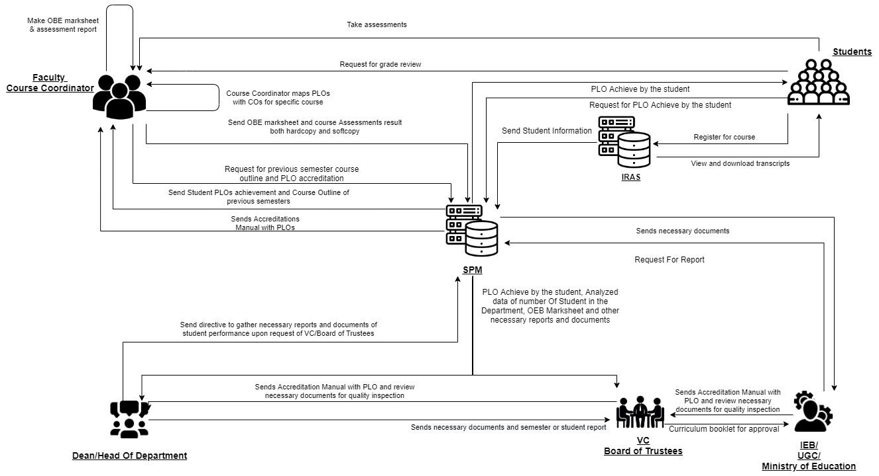
Rich Picture (TO-BE)

Slide 13
SIX ELEMENTS (TO-BE)
Process | System Roles
 | Human | Non-Comp Hardware | Computing Hardware | Software | Database | Network & Communication
Map Course Outcomes (COs) to Program Learning Outcomes (PLOs) | IEB/UGC/ Ministry of Education: 1. Send Accreditation Manual with PLOs defined to VC/ Board Of trustees. VC/ Board Of trustees 1. Receive Accreditation Manual from IEB. 2. Send the Accreditation manual to Department Staff. Head of Department / Dean of School: 1. Receive Accreditation Manual from IEB. 2. Send the Accreditation manual to SPM 3. Direct Department Staff to tell Course Instructors and Coordinators to design Course Outline and Course Assessment Reports. Course Instructor: 1.Check if previous course content is present from SPM, otherwise make new course content. 2. List COs. 3. Map Course Content to Course Outcomes (COs). 4. Map COs to PLOs. 5. Map COs to specific questions of Mid-term, Final Exams questions and Project Work. 6. Starting to design course assessment report using course outline, Course Content and COs | Pen and paper: 1. Is used for noting down intermediate brainstorming ideas. Board and marker: 1. Is used for noting down intermediate brainstorming ideas. | Computer: 1. Course Coordinators use computers to make soft copies of Course Outcomes (COs) of the specific courses they are experts in. Printer: 1. To print out hard copies of Course Outcomes (COs). | MS Word: 1. Course Coordinators use MS Word to make a detailed course outline and Course Assessment Reports with Course Outcomes (COs) mapping to Program Learning Outcomes (PLOs). Excel Sheet: 1. Excel Sheet is used by Course Coordinators to map specific questions in the Midterm, Final exams and Project work to specific Course Outcomes (COs). | Department Storage: 1. Records of students’ enrollment in the department. Registrar’s Office Storage: 1. Records of students’ enrollment for all the departments. | 1. Use the internet and emails to communicate with UGC/IEB or other stakeholders to discuss important topics related to mapping Course Outcomes to Program Learning Outcomes. Others: 1. Use phones or physical means with stakeholders to discuss important topics related to mapping Course Outcomes to Program Learning Outcomes.

Slide 14
Process | System Roles
 | Human | Non-Comp Hardware | Computing Hardware | Software | Database | Network & Communication
Check Number of student enrollment in a department from SPM | Student: 1. Students enroll in a specific Degree program. 2. Student information is sent to SPM from IRAS. Department Head/Dean: 1.Recieve the data from SPM 2. School-wise, department-wise, and program-wise student enrollment comparison can be seen. VC/Board of Trustees: 1.Recieve the data from SPM 2. School-wise, department-wise, and program-wise student enrollment comparison can be seen. | Pen and Paper 1. Sheet of a number of students in a department is made along with student’s information. | Computer/ Phone: 1. Uses computers to make softcopies of reports or sheets of student information in departments. Printer: 1. Print hard copies of report and sheet | Coded Excel sheet: 1.Department head or dean uses automated excel sheets to calculate the number of student’s in the department. MS Word: 1. Used to make report softcopies. | IRAS database 1. Records of students’ enrollment in the department. SPM database: 1. Records of students’ enrollment for all the departments. | Internet/Mail: 1. An Online platform (such as Google Sheets) may be used for processing the student information data spreadsheet. 2. Internet to access to SPM

Slide 15
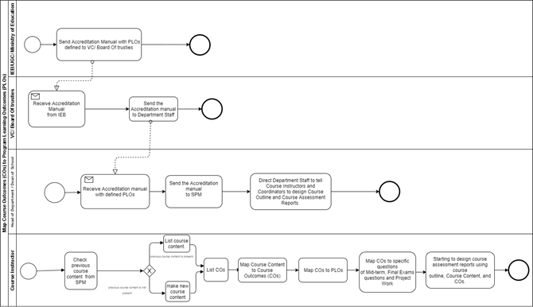
PROCESS DIAGRAM (TO-BE)
Figure 2.12: Process diagram for Map Course Outcomes (COs) to Program Learning Outcomes (PLOs)

Slide 16
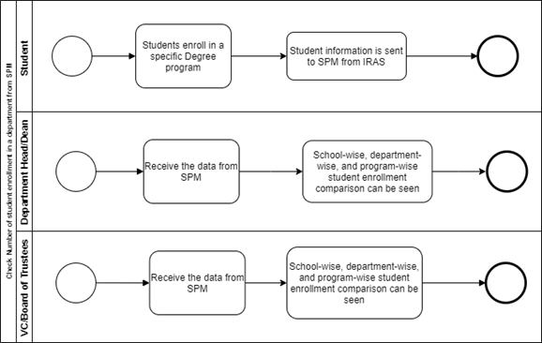
Figure 2.13: Process diagram for Check Number of student enrollment in a department from SPM

Slide 17
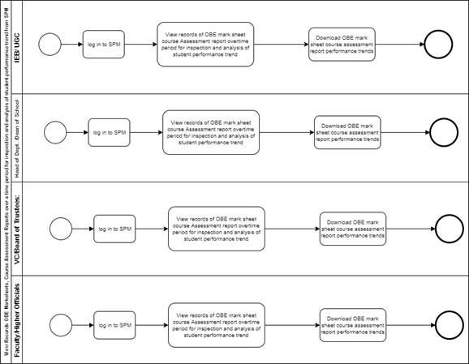
Figure 2.19: Process diagram for View Records OBE Marksheets, Course Assessment Reports over a time period for inspection and analysis of student performance trend from SPM

Slide 18
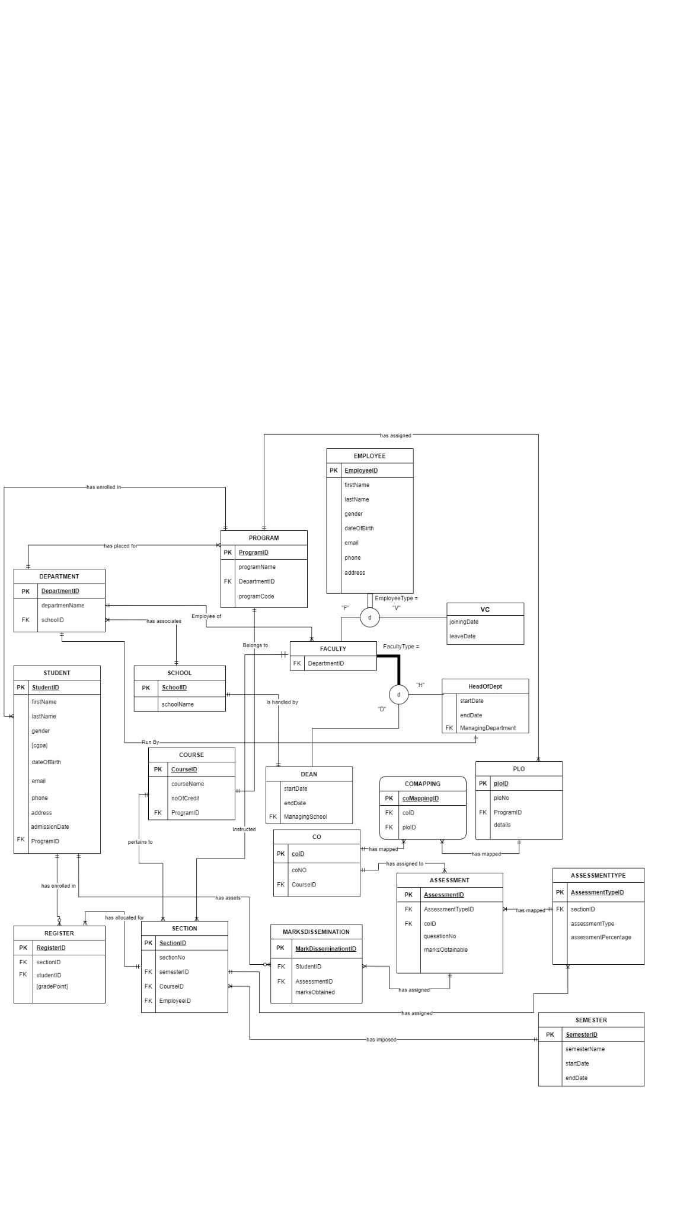
ERD

Slide 19
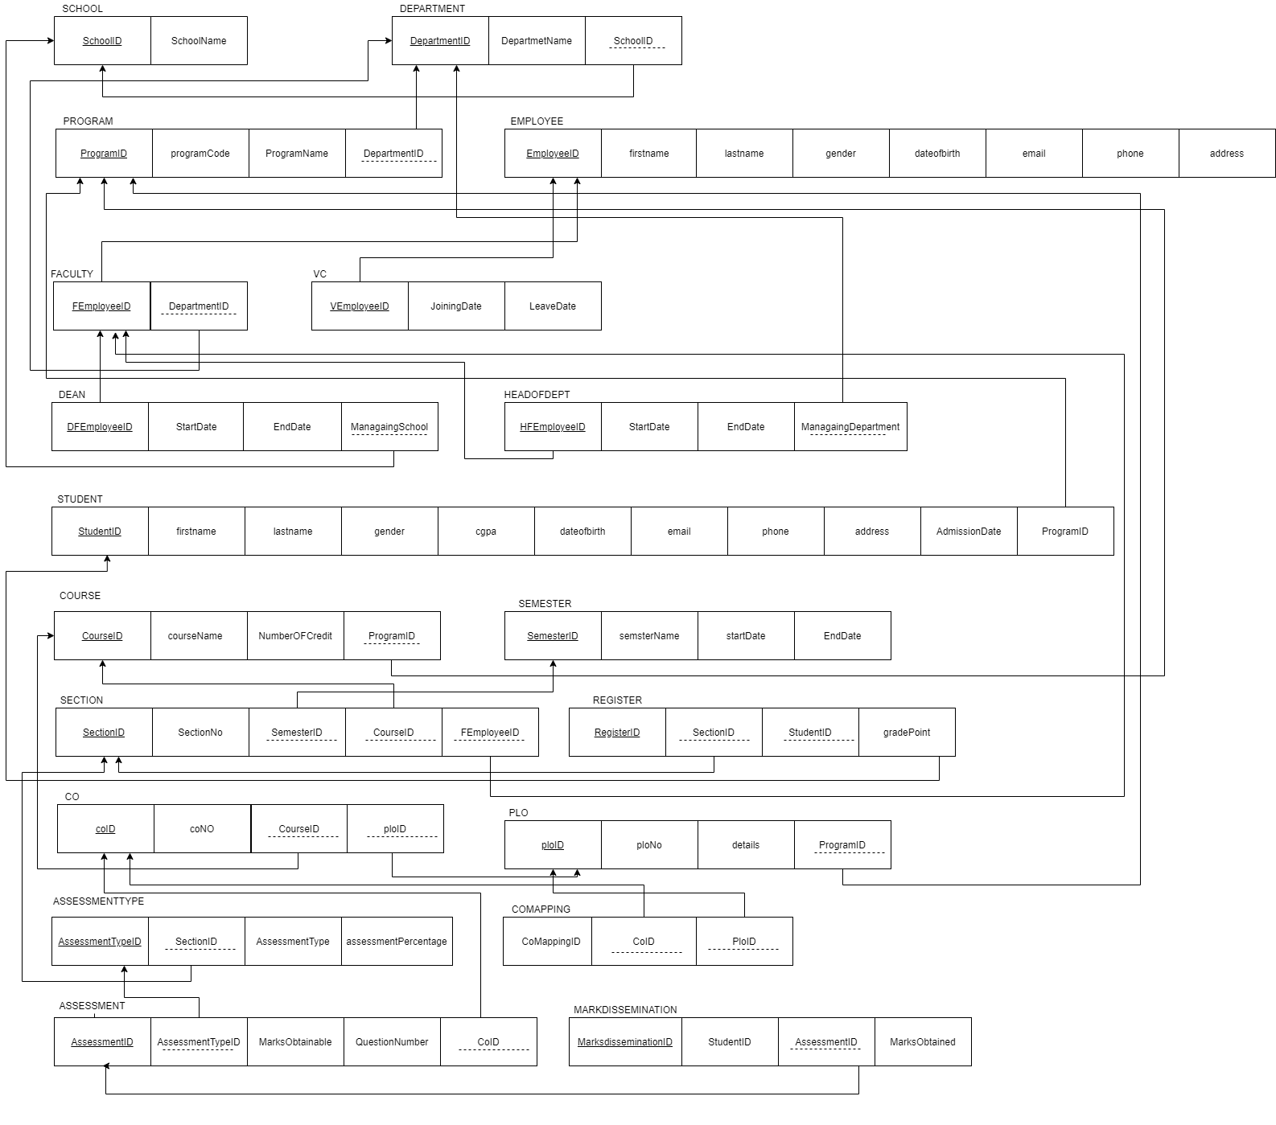
RELATIONAL SCHEMA

Slide 20
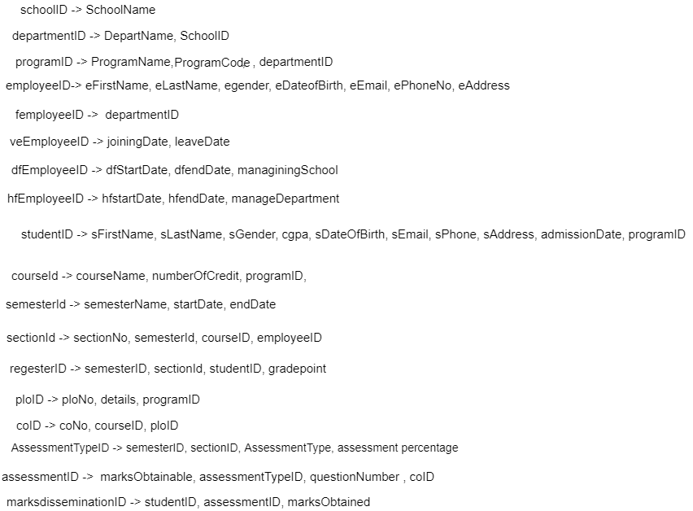
NORMALIZATION

Slide 21
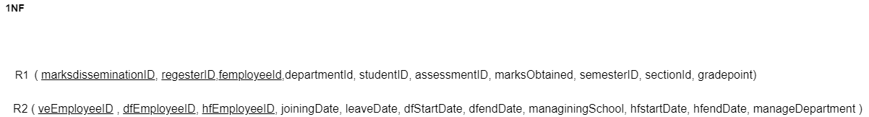
1NF

Slide 22
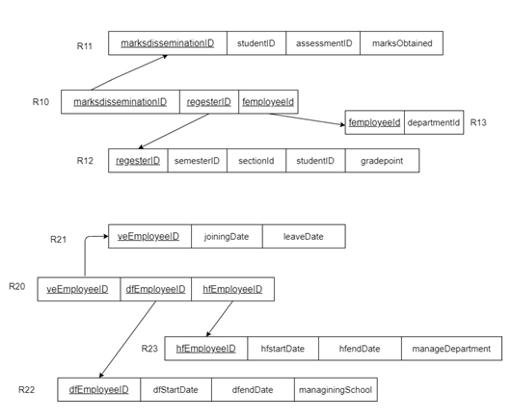
2NF

Slide 23
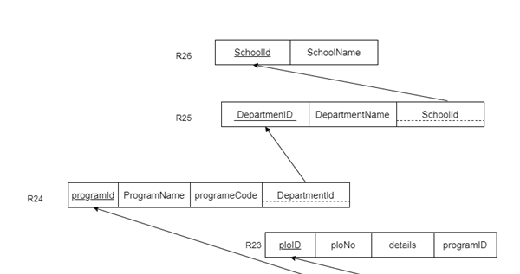
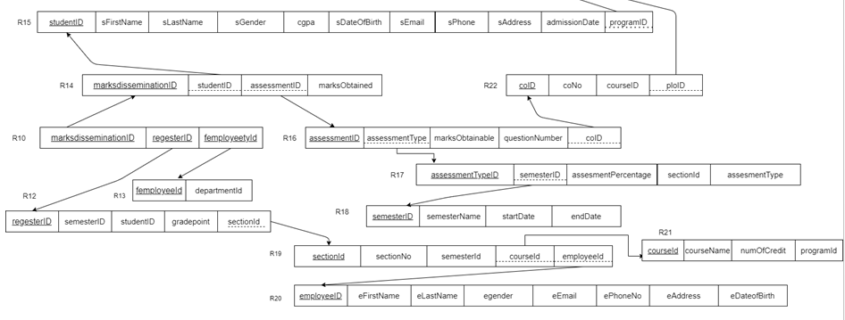
3NF

Slide 24
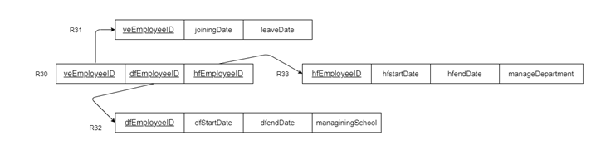

BCNF :

Slide 25
Language use
Front end:
HTML, CSS, Bootstrap
Database:
MySQL
Backend:
PHP,laravel

Slide 26

Implementation :
Registration page

Slide 27
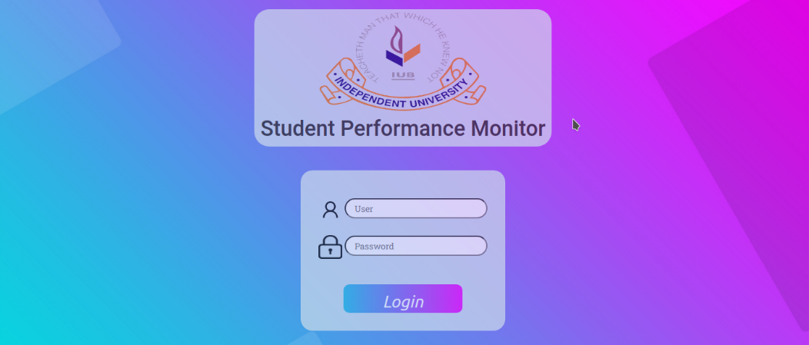
Login Page

Slide 28
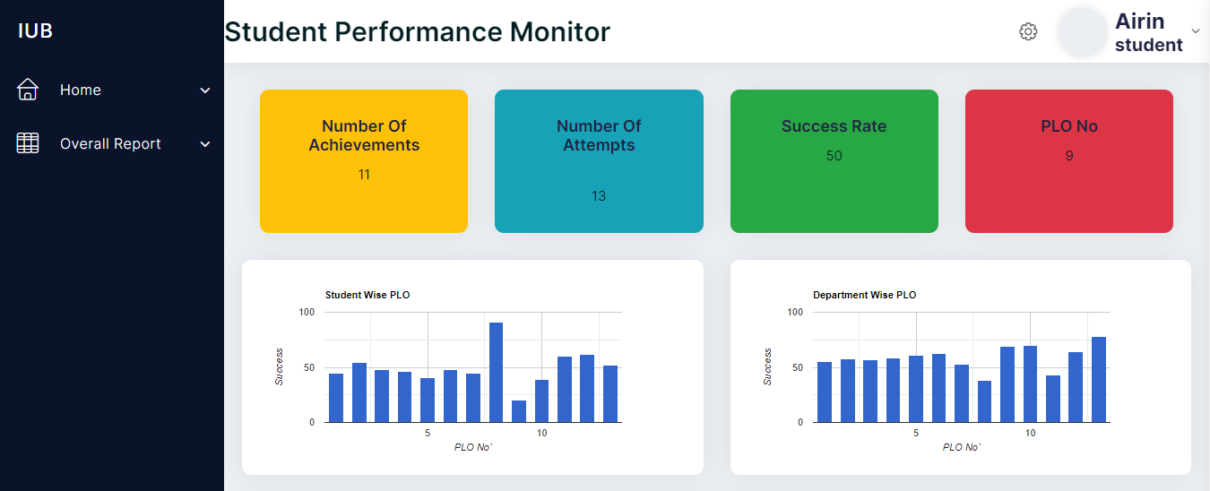
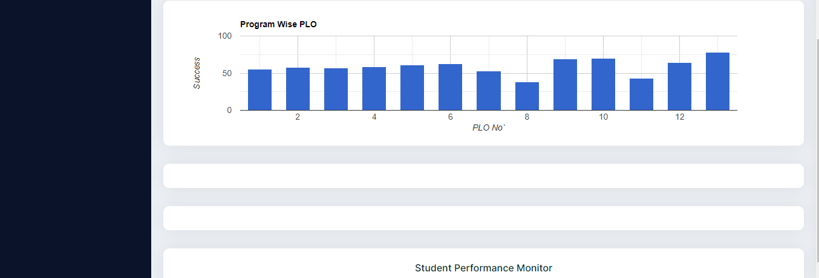
Student Dashboard

Slide 29
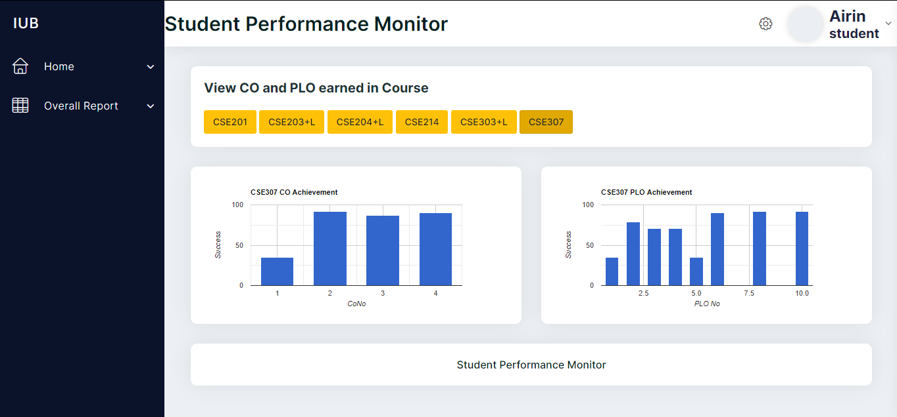
Overall Report Page:

Slide 30
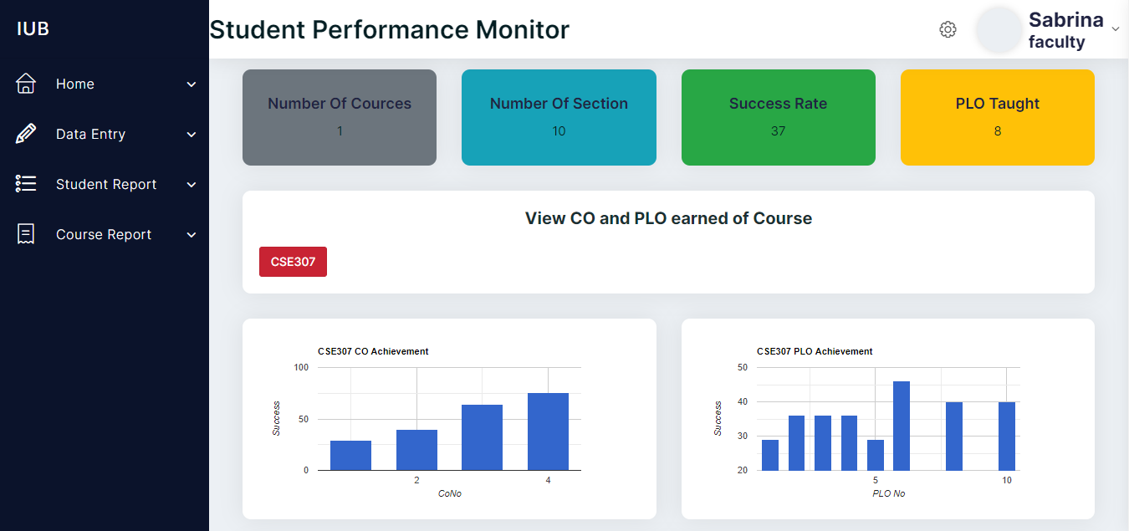
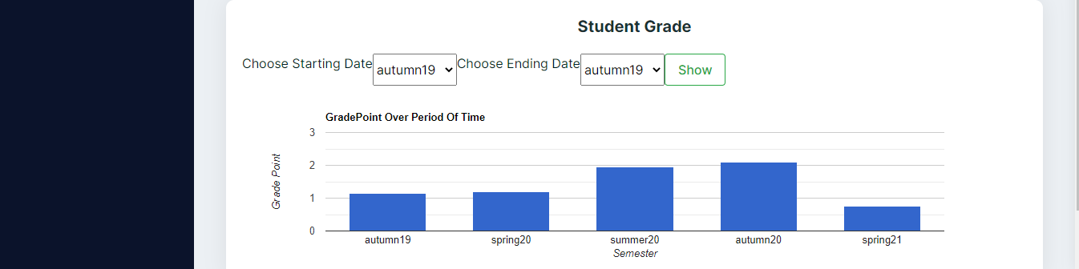
Faculty Dashboard

Slide 31
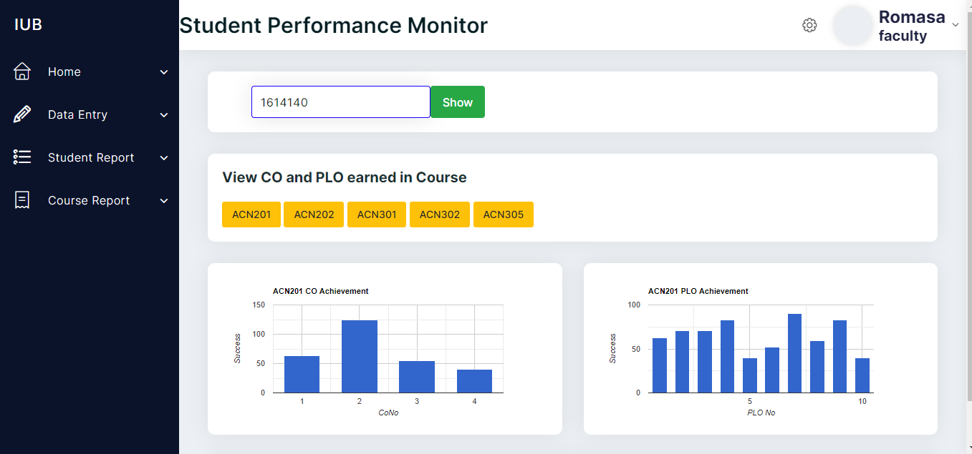
Student Report Page:

Slide 32
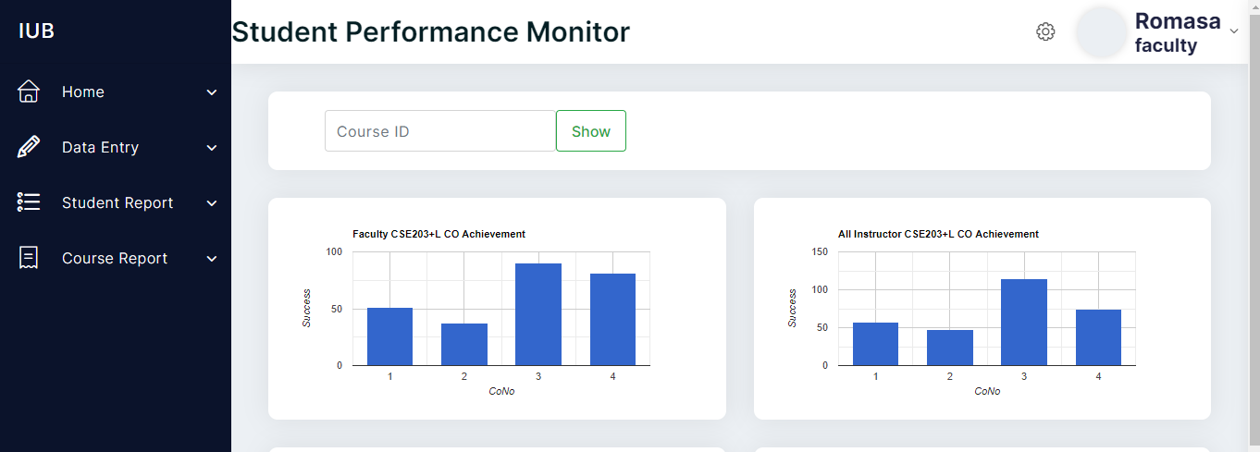
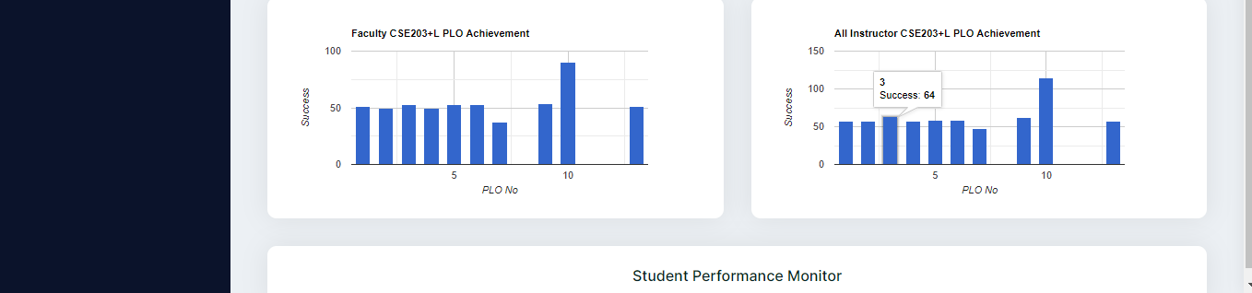
Course Report Page:

Slide 33
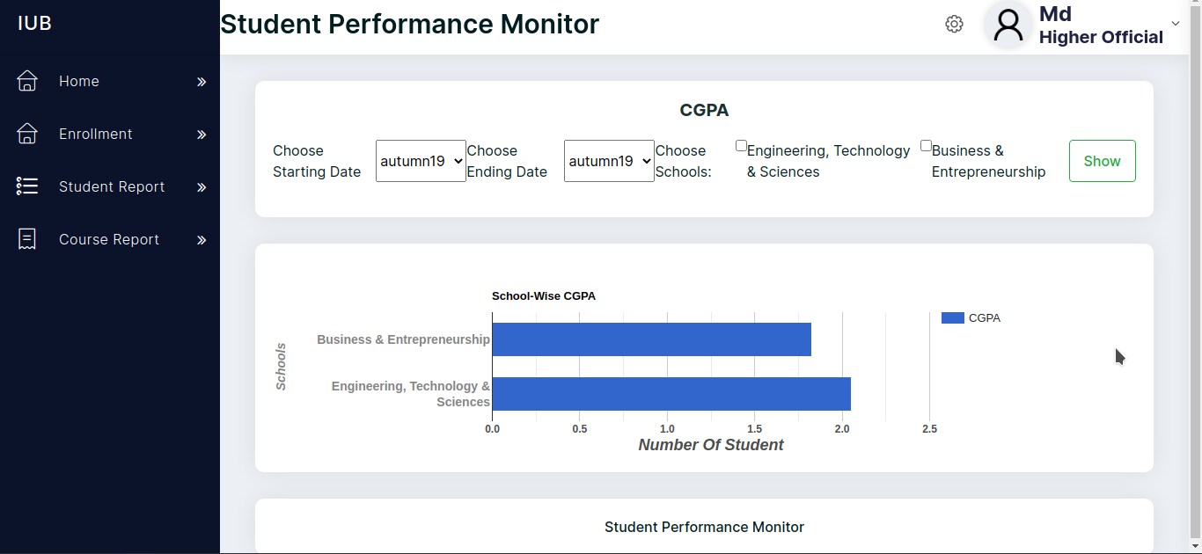
Higher Official Dashboard
Department Wise Students CGPA

Slide 34
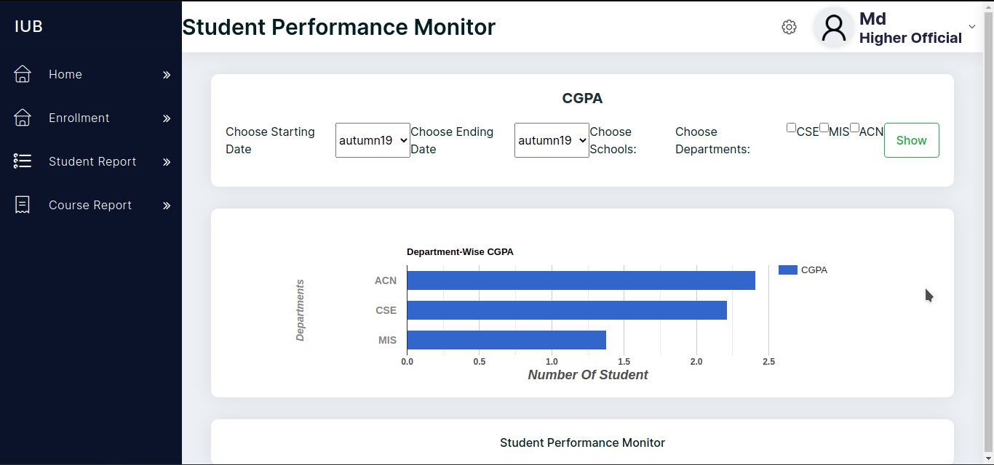
School Wise Students CGPA

Slide 35
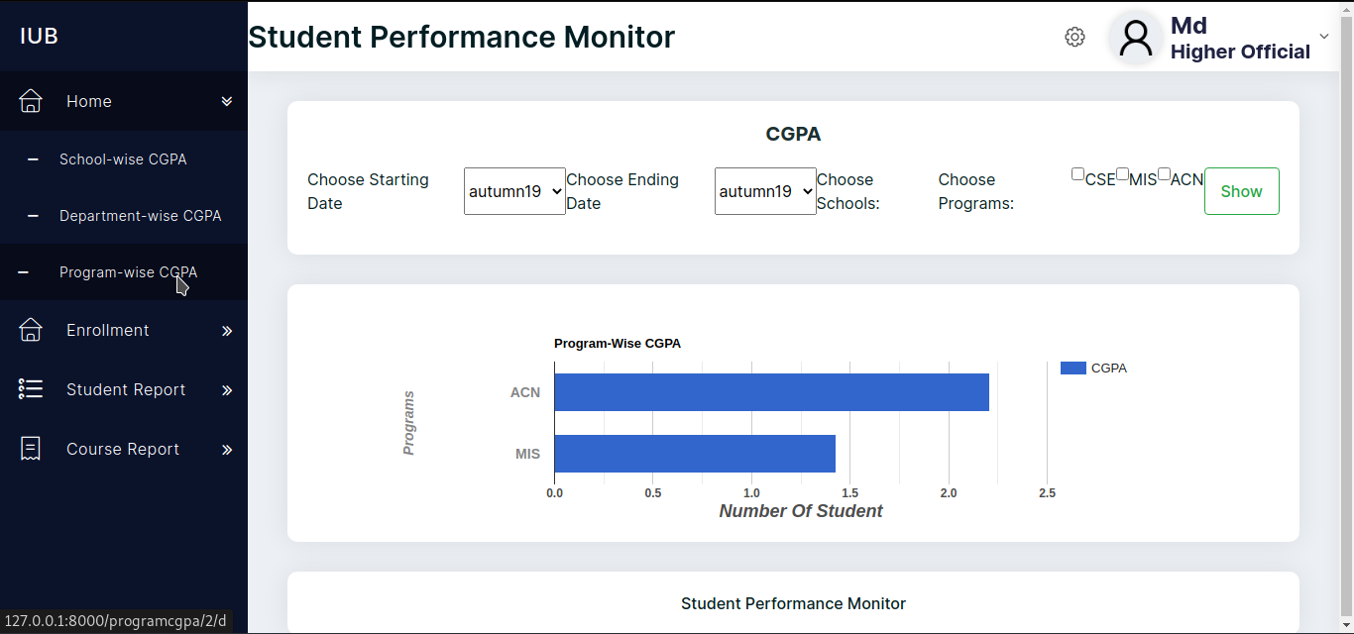
Program Wise Students CGPA

Slide 36
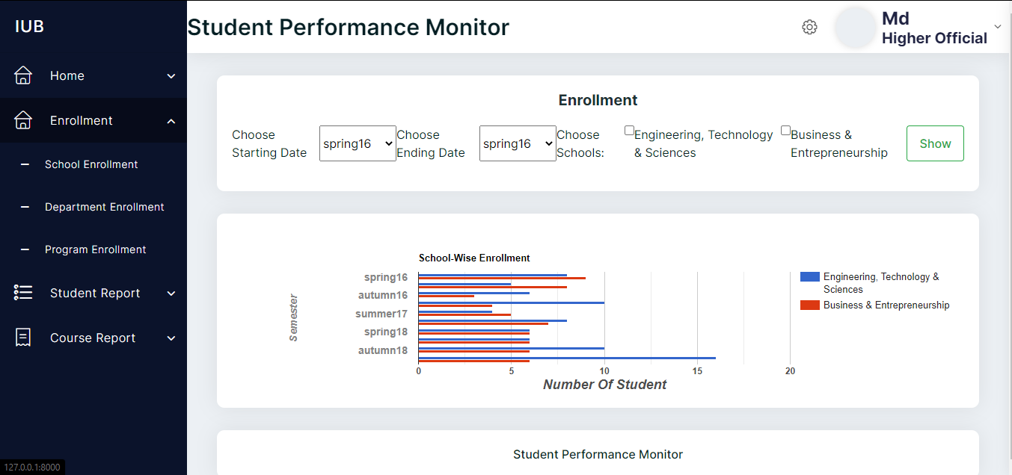
School Wise Student Enrollment Page

Slide 37
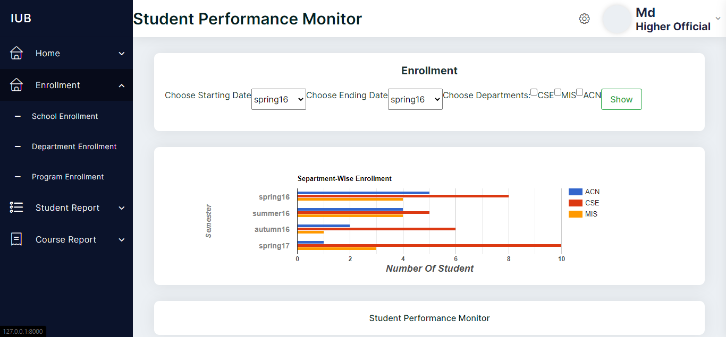
Department Wise Student Enrollment Page

Slide 38
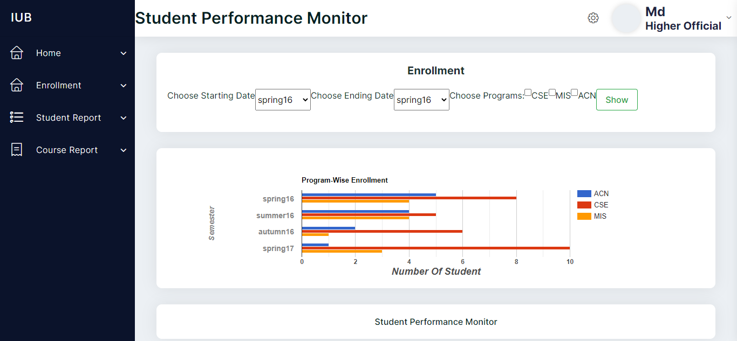
Program Wise Student Enrollment Page

Slide 39
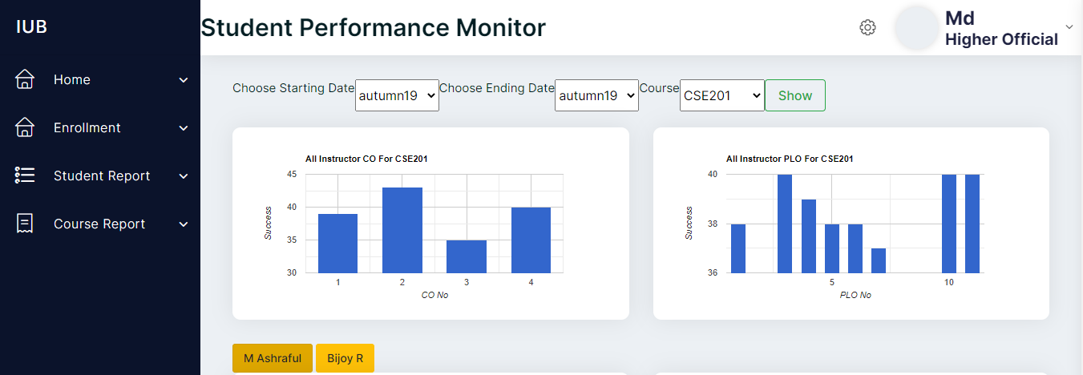
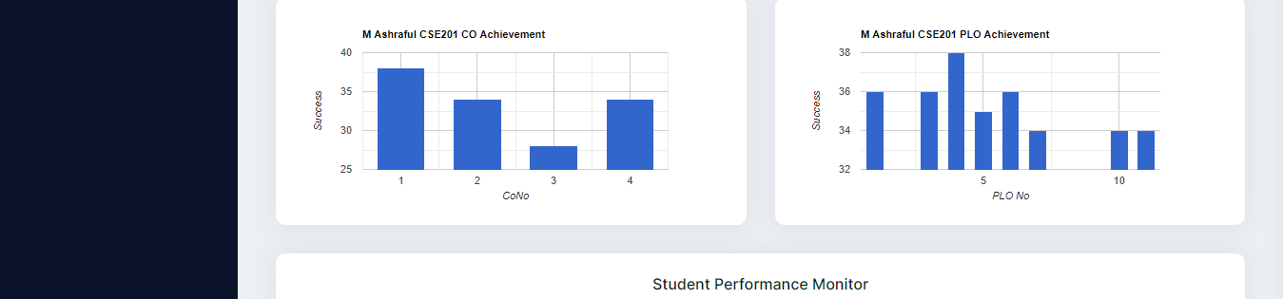
Course Report Page

Slide 40
PROBLEM AND SOLUTION
Lack of communication among the team mates.
Not being able to get the most update and accurate data.
Was hard to manage a same database for the ADMINS and STAKEHOLDERS to maintain the work in the same website.
Formatting the data in a proper way, as all the universities has a unique way to upload their file.
The limited time limit of the semester has prevented us from achieving the full potential of this software. If we had to get chances to gain more resources and data to work with, we could believe we could have achieved much more reliable and accurate results, representations and predictions.

Slide 41
ADDITIONAL FEATURES AND FUTURE DEVELOPMENT
1. The addition of an assessment page where faculties will be able to add marks for a specific assessment of a student throughout the term. Our SPM will automatically generate the achieved CO and PLO.
2. Users will be expanded to also include advisors, where advisors will get relevant information about the students they're advising for improved and more beneficial interactions between students and advisors.
3. The addition of Curriculum Page in the SPM where members of the Higher Management team can add and edit any changes to curriculum. Moreover, faculty members and students can check these updates to stay informed about the latest changes.

Slide 42
Conclusion:
In conclusion, our website was designed keeping easy for user. The website has no learning purpose as everything is very simple and basic. It remains user friendly for the users to be able to adapt to the environment in a grasp. Because of our website now this work requires less human involvement, increases efficiency and consumes less time. So we believe that our proposed system is now more beneficial and efficient for this work

Slide 43
Thank You

